Slide 1
Financial Accounting
IFRS 5th Edition
Weygandt ● Kimmel
Chapter 11
Non-Current Liabilities
This slide deck contains animations. Please disable animations if they cause issues with your device.
Copyright © John Wiley & Sons, Inc.
Notes:
Current liab: Obligation due within 1 year or 1 operating cycle
Non-current: More than one year or more than 1 operating cycle.

Slide 2
Chapter Outline
Learning Objectives
LO 1 Describe the major characteristics of bonds.
LO 2 Explain how to account for bond transactions.
LO 3 Apply the effective-interest method of amortizing bond discount and bond premium.

Slide 3
Non-Current Liabilities
Obligations that a company expects to pay more than one year (or one operating cycle, whichever is longer) in the future
Examples:
Bonds
Long-term payables

Slide 4
Learning Objective 1 Describe the Major Characteristics of Bonds.
L O 1

Slide 5
Different Methods of Financing
Debt Financing
Borrowing money that you will pay back to lender, with interest
Will affect liabilities; interest expense
Used when have stable cash flow that covers interest payment. No upside for investor.
Equity Financing
Company raises money by selling shares of itself. Exchanging portion of ownership of the company for cash
Affect shareholder’s equity
Used when company do not want pressure of interest payment. Investor has upside.

Slide 6



Debt financing
How does companies borrow money?

Slide 7
Overview of Bonds
Bonds are a form of interest-bearing notes payable issued by companies (公司债), and governments (国债).
The bond market (also debt market/credit market/fixed income market) is a financial market where participants can buy and sell government/corporate bond.
Sold in small denominations (usually €1,000 or multiples of €1,000).
When a company/government issues bonds, it is borrowing money. The person who buys the bonds (the bondholder) is lending money.
The bond buyers are often institutions, i.e., hedge fund, pension fund, endowments, mutual funds, etc, and some individuals.

Slide 8
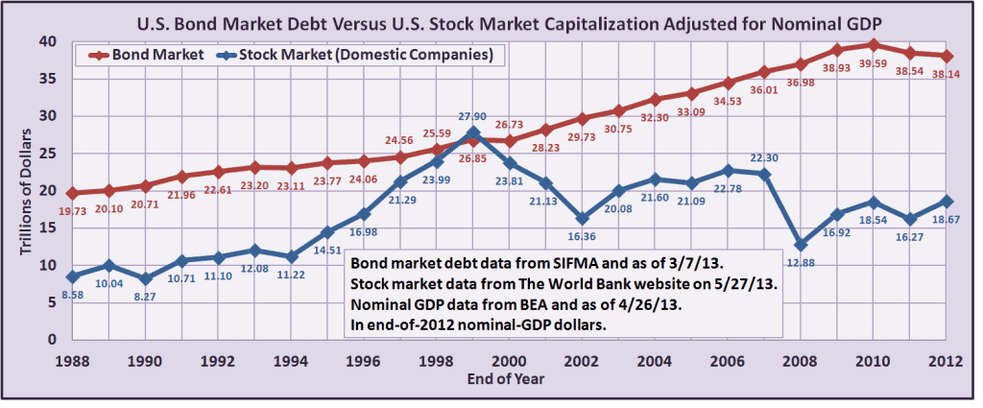
Bond market is larger than the stock market
https://learnbonds.com/news/how-big-is-the-bond-market/

Slide 9
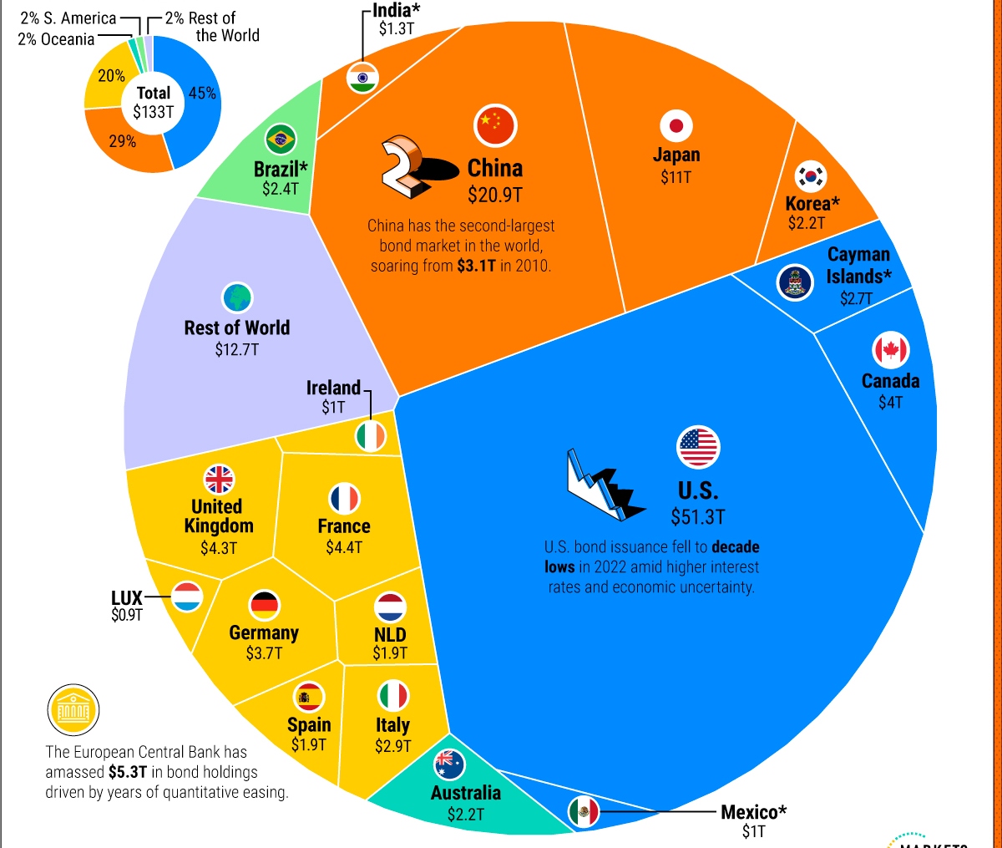
Bond market size by country

Slide 10
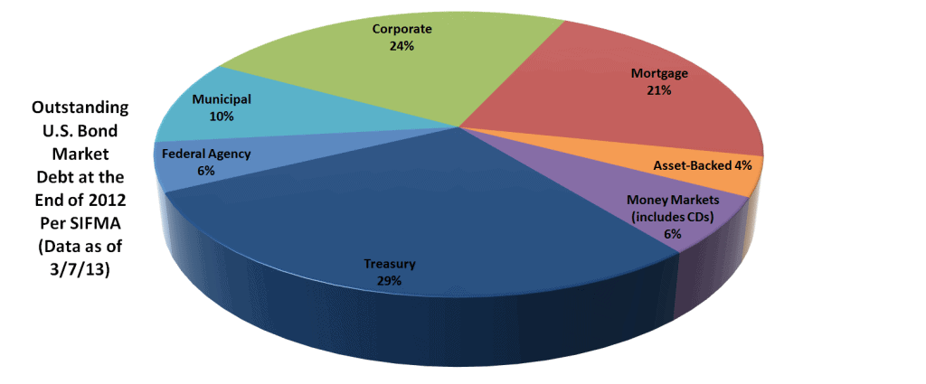
Who issues bond
Caused 2008 financial crisis. If interested, you can watch the movie the big short
政府债/国债

Slide 11
Types of Bonds
Secured and Unsecured Bonds
Secured bonds have specific assets of issuer pledged as collateral for bonds
In case of bankruptcy, bondholder will have claim on the collateral.
Unsecured bonds are issued against general credit of borrower
No collateral involved. Borrower is using their credit (i.e., reputation) to borrow.
L O 1

Slide 12
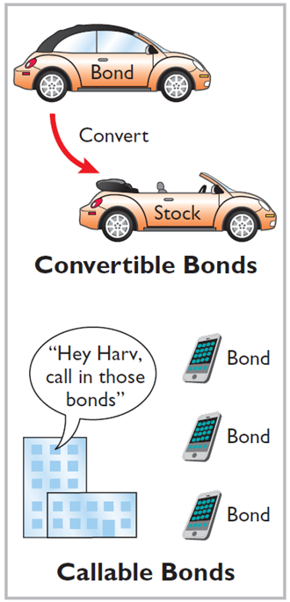
Additional Types of Bonds
Convertible and Callable Bonds
Convertible bonds can be converted into ordinary shares at bondholder’s option
Callable bonds can be redeemed (bought back), by issuing company, at a stated currency amount prior to maturity
L O 1
Notes:
Issuer is borrower.
Bondholder is lender.

Slide 13
Issuing Procedures
Government laws grant companies power to issue bonds
Board of directors and shareholders usually must approve bond issues
Board of directors must stipulate number of bonds to be authorized, total face value, and contractual interest rate
Terms of bond are set forth in a legal document called a bond indenture
Find an investment bank to sell the bond to investors (underwriting)
L O 1

Slide 14
Bond Terminology
Bond certificate
Issued to investor
Provides name of the issuer, face value, contractual interest rate, and maturity date
Face value - principal due at maturity
Amount of money that will be paid back to investor. May not be amount of money borrowed.
Maturity date - date final payment is due
Contractual interest rate – annual rate used to determine cash interest paid, also referred to as the stated rate or coupon rate
L O 1
Notes:
Face value: amount of money that will be paid back to investor (different from notes payable case)… may not be amount of money borrowed.
Everything wil be specificed on bond certificate.

Slide 15
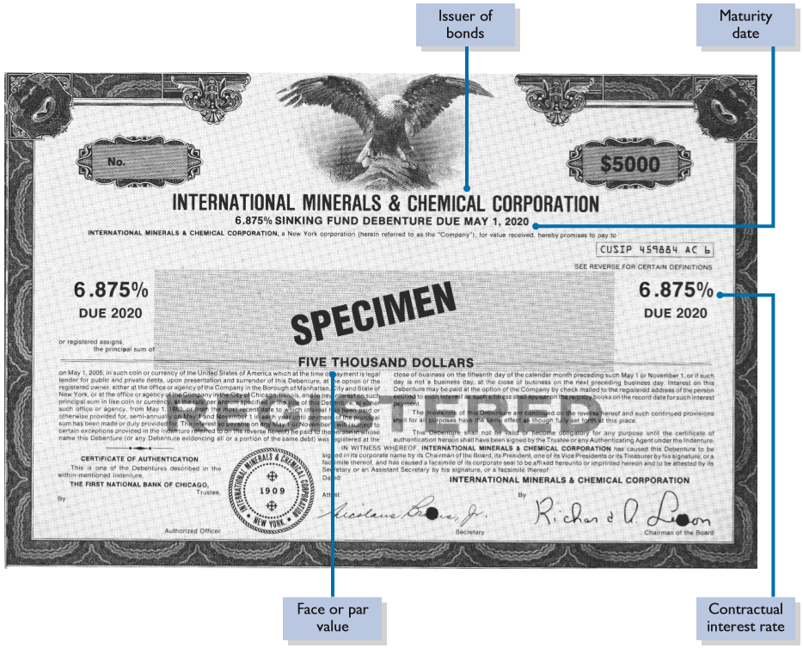
Bond Certificate
Illustration 11.1: Bond certificate
L O 1

Slide 16
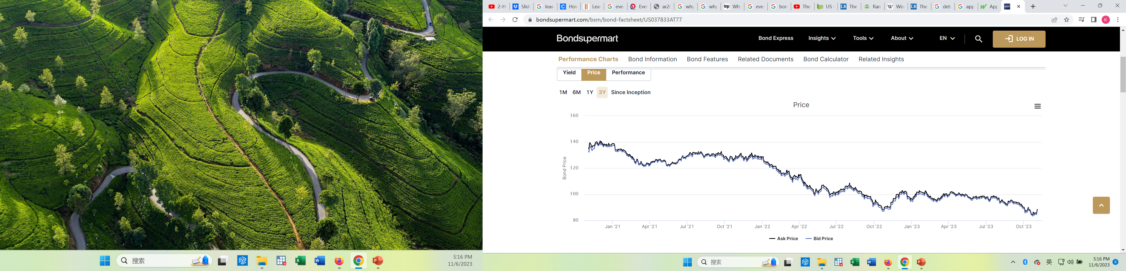

Bond Trading
Bondholders can sell their bonds at any time on national securities exchanges
Bonds prices are quoted as a percentage of face value
Market information for bonds:
L O 1
Notes:
Can also trade bonds.

Slide 17
Determining the Market Price of a Bond
Current market price (present value) of a bond is a function of three factors:
amounts to be received,
length of time until amounts are received, and
market rate of interest (investor demanded rate).
market rate of interest is often not the contractual/stated interest rate
L O 1

Slide 18
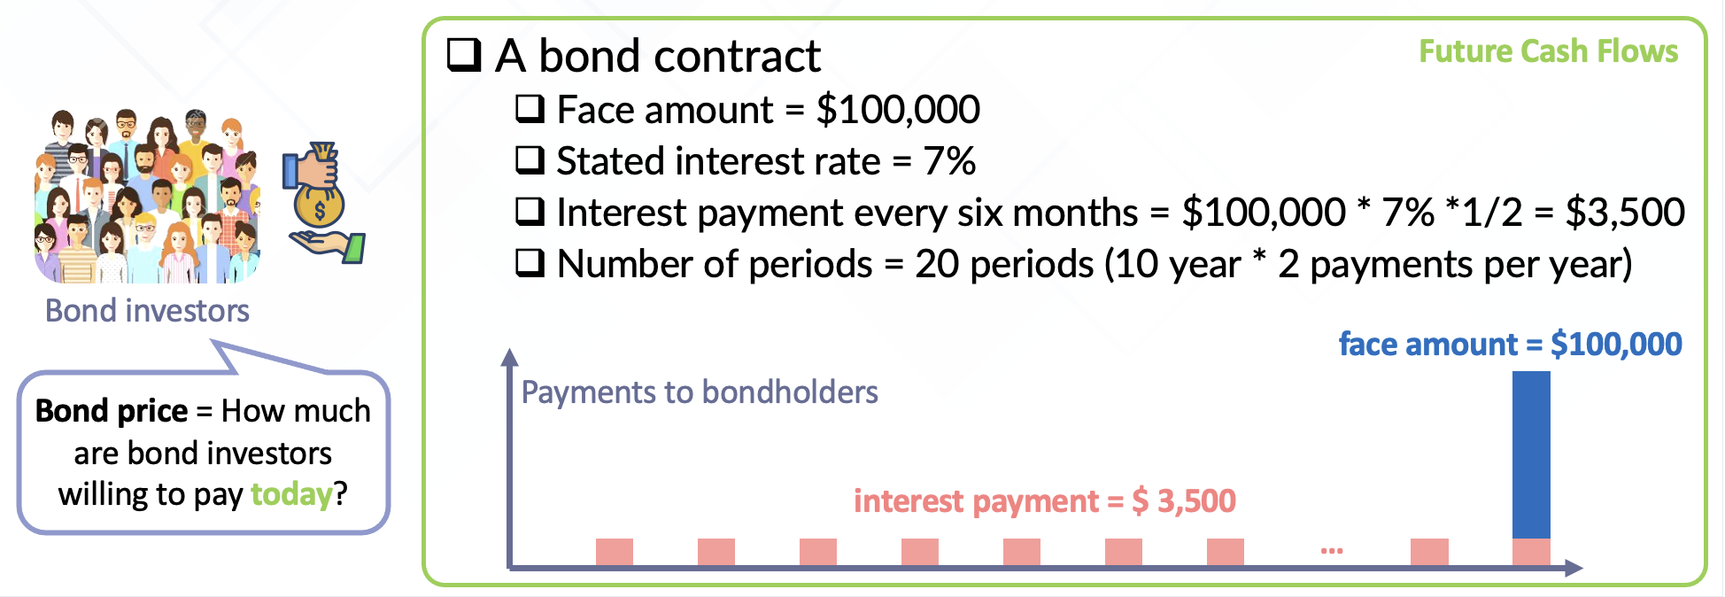
Bond Pricing
On January 1, 2021, California Coasters raises money for development of new roller coaster by issuing $100,000 of bonds, paying a stated interest rate of 7% each year. The bonds are due in 10 years, with interest payable semi-annually on June 30 and December 31.
Notes:
Company raise money by issuing bond… face amount is $100,000 → amount to be paid at maturity
stated interest rate: interest rate on the bond certificate.
Bond due in 10 yrs, semi-annual payment.
Investor will receive two different sets of CF
Face amount = $100,000 at the end of 10 years
Int Pmt: 35,000 each six months ($100,000 * 7% * ½)… this is calculated by the stated interest rate.
Question: If bond can provide this CF, at which price will the bond be sold for today? This is the issue price.
In order to answer this question, we need to think about the time value of money.

Slide 19
DO IT! 1: Bond Terminology – Solution
State whether each of the following statements is true or false.
The stated interest rate is the rate investors demand for loaning funds. False
market rate of interest is the investor demanded rates; sometimes this rate is also called discount rate or effective rates or yield to maturity.
The face value is the amount of principal the issuing company must pay at the maturity date. True
L O 1

Slide 20
Time value of the money
Which of the following do you prefer?
Receive $1,000,000 today
Receive $1,000,000 in 10 years

Slide 21
Time value of the money
Which of the following do you prefer?
Receive $1,000,000 today
Receive $1,005,000 in 10 years

Slide 22
Time value of the money
Which of the following do you prefer?
Receive $1,000,000 today
Receive $100,000,000 in 10 years

Slide 23
Time value of the money
Time value of money is used in calculation of the issue price of bond
Value of money can be different at different points in time.
$1 today is worth more than $1 in one year
Because over time, you can use money to generate returns
Compound interest is used in calculating the time value of money
Compound interest is the interest earned on the initial investment and on previous interest

Slide 24
Revisiting Bond Pricing

Slide 25
Revisiting Bond Pricing
Need to understand that there are two parts in bonds
Face Amount: $100,000 in 10 years
PV of single amount
Interest Pmts: $3,500 semi-annually
PV of annuity (cash payment of equal amount over time periods of equal length)
We need to compute what these two components are worth today.

Slide 26
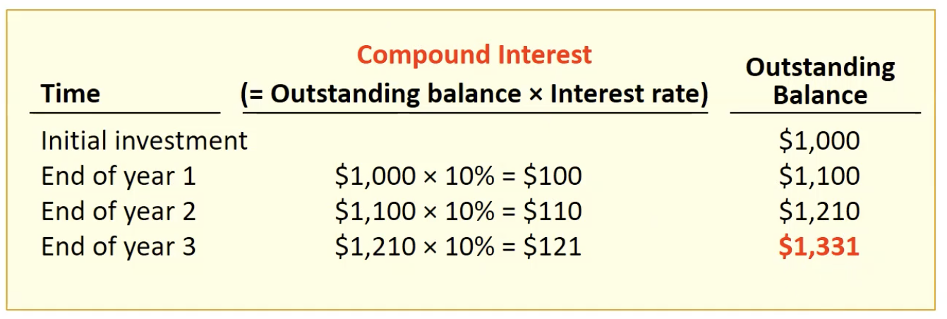
Future Value and Present Value
Suppose you put $1,000 into a savings account that pays compound interest of 10%. You withdraw the money at the end of the three years.
Notes:
1331 is future value of money … i.e., $1000 today is worth $1331 in 3 years.
1000 is present value of money … i.e., $1331 in 3 years is worth $1000 today.

Slide 27
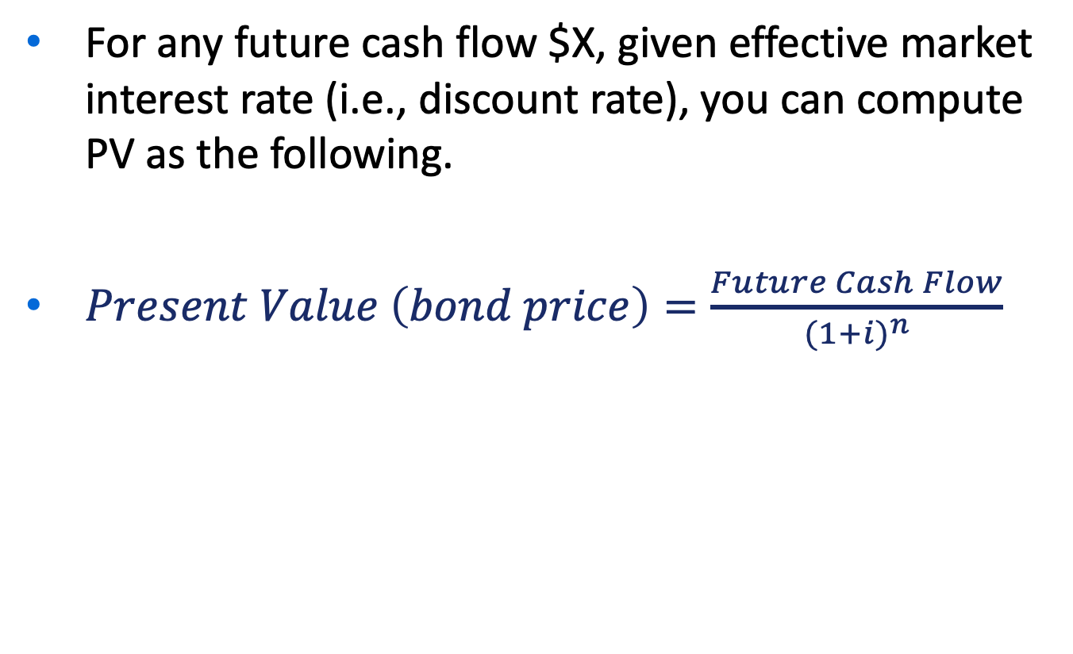
Formula: PV of Single Amount
For any future cash flow $X, given effective market interest rate (i.e., discount rate), you can compute PV as the following.
$Present Value \left(bond price\right)=\frac{Future Cash Flow}{{(1+i)}^{n}}$

Slide 28
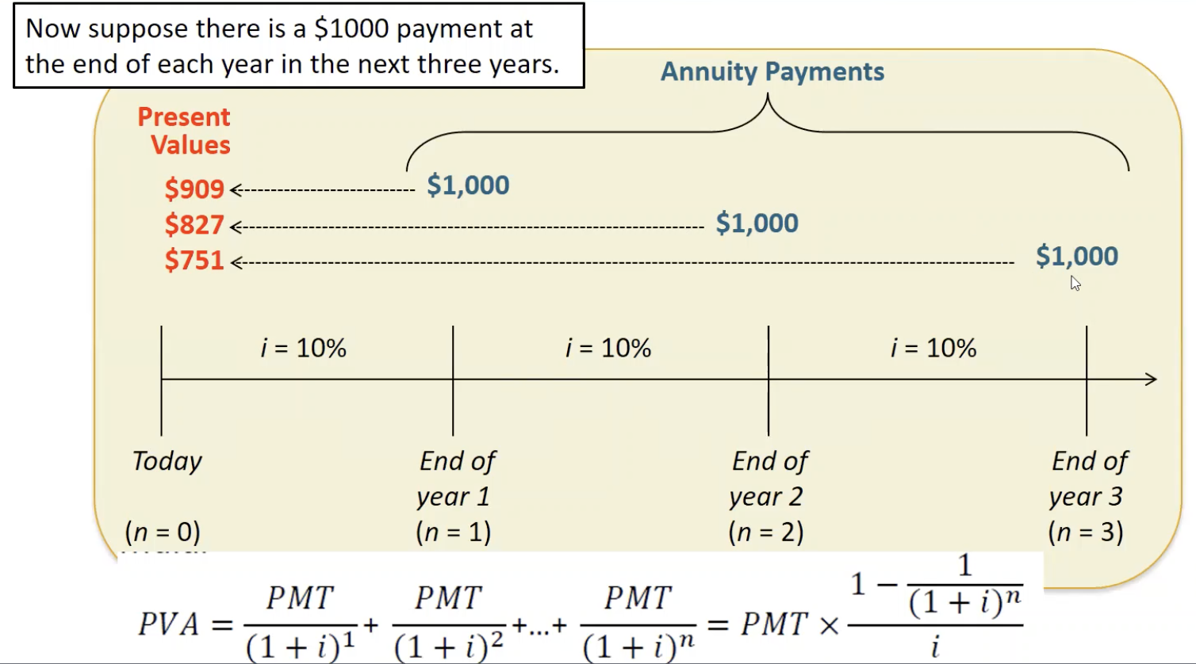
PV of Annuity
Notes:
At end of each period, we receive equal amount. This is called an annuity.

Slide 29
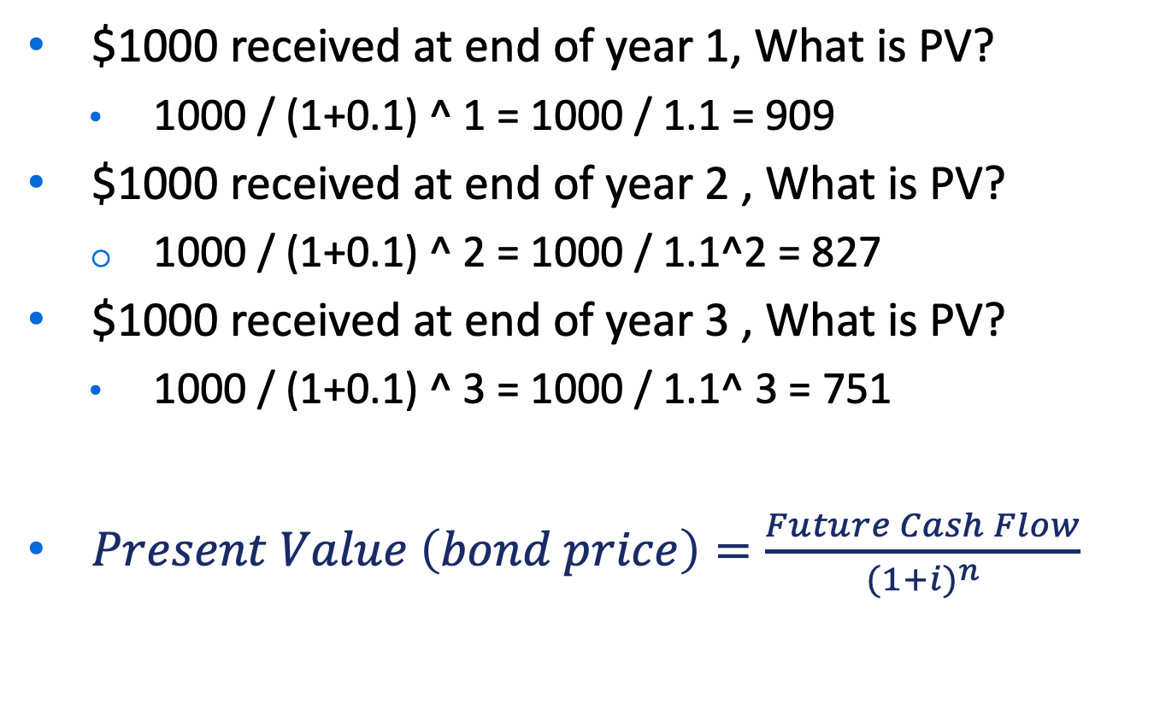
Formula: PV of Annuity
$1000 received at end of year 1, What is PV?
1000 / (1+0.1) ^ 1 = 1000 / 1.1 = 909
$1000 received at end of year 2 , What is PV?
1000 / (1+0.1) ^ 2 = 1000 / 1.1^2 = 827
$1000 received at end of year 3 , What is PV?
1000 / (1+0.1) ^ 3 = 1000 / 1.1^ 3 = 751
$Present Value \left(bond price\right)=\frac{Future Cash Flow}{{(1+i)}^{n}}$

Slide 30
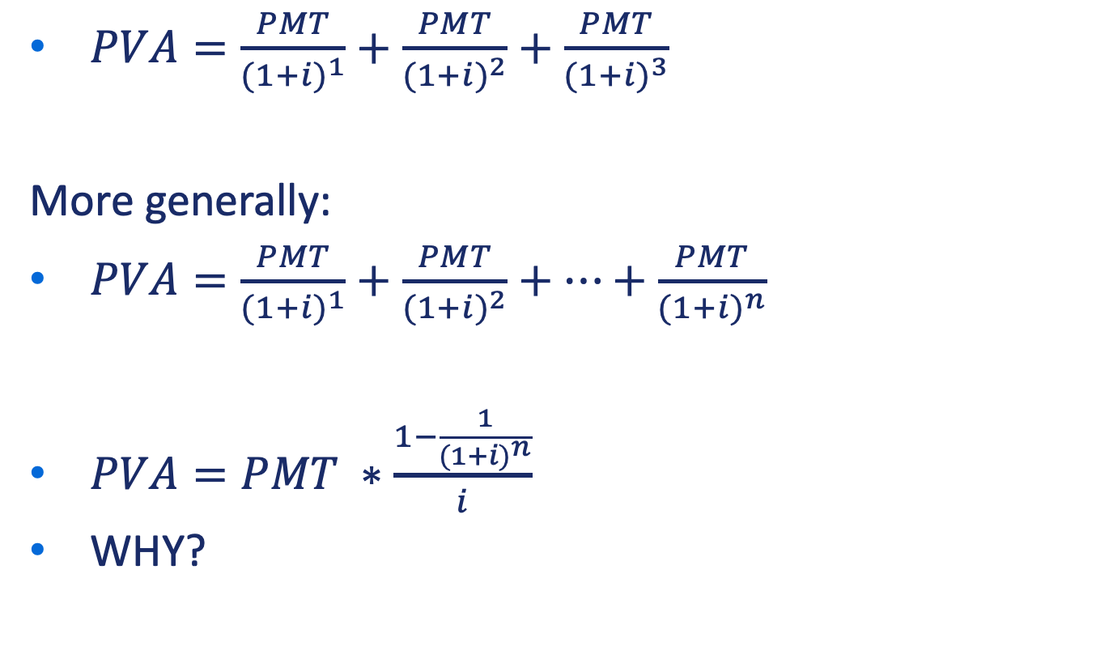
PV of Annuity (Cont’d)
$PVA=\frac{PMT}{{(1+i)}^{1}}+\frac{PMT}{{(1+i)}^{2}}+\frac{PMT}{{(1+i)}^{3}}$
More generally:
$PVA=\frac{PMT}{{(1+i)}^{1}}+\frac{PMT}{{(1+i)}^{2}}+…+\frac{PMT}{{(1+i)}^{n}}$
$PVA=PMT ∗\frac{1−\frac{1}{{(1+i)}^{n}}}{i}$
WHY?

Slide 31
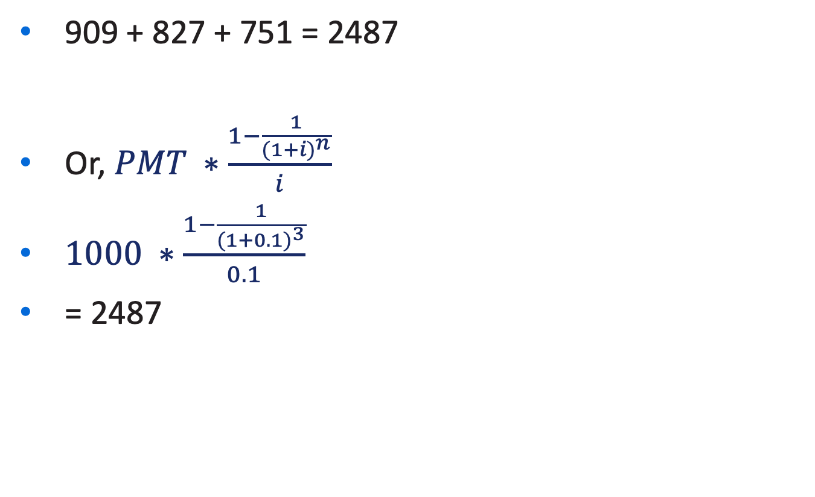
PV of Annuity (Cont’d)
909 + 827 + 751 = 2487
Or, $PMT ∗\frac{1−\frac{1}{{(1+i)}^{n}}}{i}$
$1000 ∗\frac{1−\frac{1}{{(1+0.1)}^{3}}}{0.1}$
= 2487

Slide 32
Pricing of Bond
Talked about two interest rates
The stated interest rate: Specified in the bond contract
Used to compute interest payments
The market interest rate: not specified in the bond contract.
Investors’ demand a higher market rate for bonds that have a higher default risk
Used to compute price of bond

Slide 33
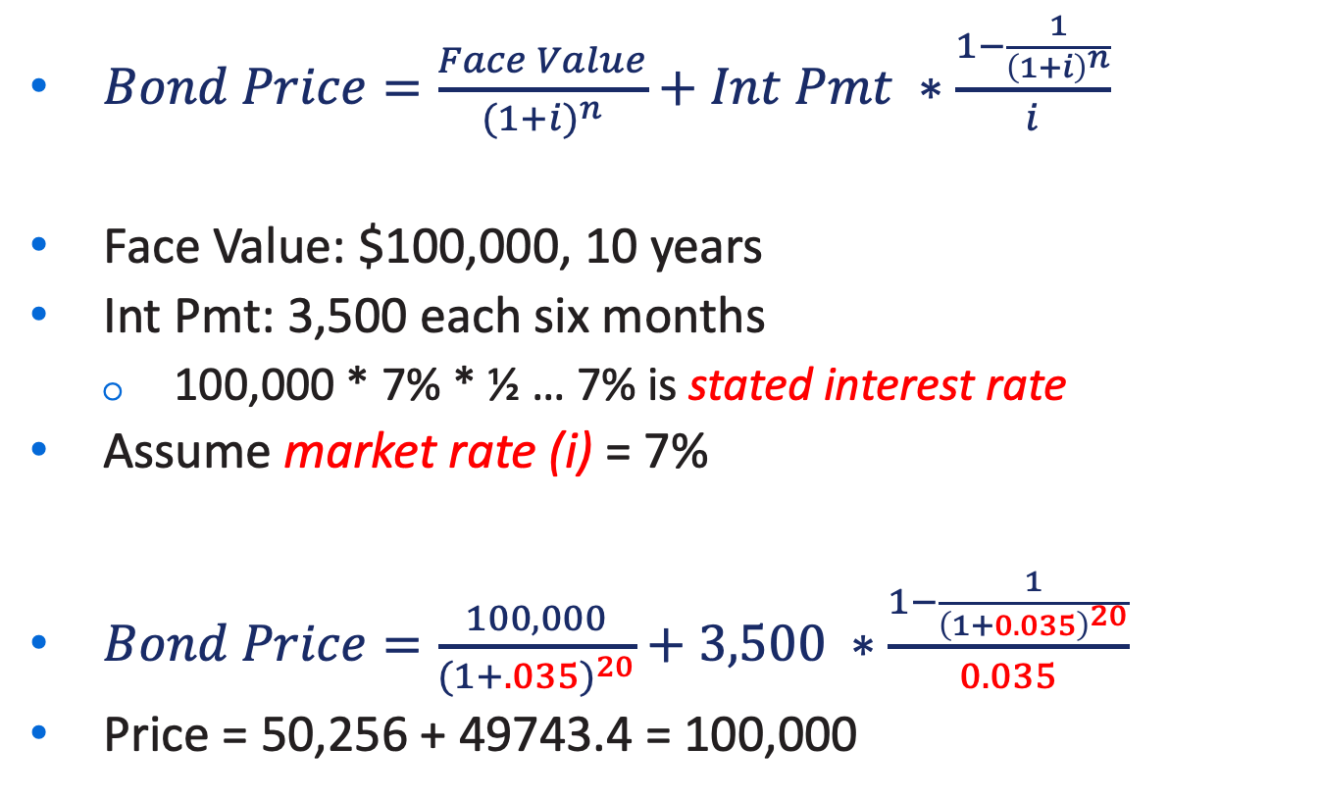
Pricing of Bond
$Bond Price=\frac{Face Value}{{(1+i)}^{n}}+Int Pmt ∗\frac{1−\frac{1}{{\left(1+i\right)}^{n}}}{i}$
Face Value: $100,000, 10 years
Int Pmt: 3,500 each six months
100,000 * 7% * ½ … 7% is stated interest rate
Assume market rate (i) = 7%
$Bond Price=\frac{100,000}{{(1+.035)}^{20}}+3,500 ∗\frac{1−\frac{1}{{\left(1+0.035\right)}^{20}}}{0.035}$
Price = 50,256 + 49743.4 = 100,000
Notes:
Bond price is determined by investors’ demand … so we need to use market rate
What happened? Current price is equal to face value?

Slide 34
Issuing Bonds
Market rate can be equal to, less than, or greater than the stated interest rate paid to investors
If market rate = stated rate, bond is issued at face amount (issued at par)
If market rate > stated rate, bond is issued at below face value (issued at discount)
Bond selling at lower price than face amount
If market rate < stated rate, bond is issued at above face amount (issued at premium)
Bond selling at higher price than face amount
L O 2

Slide 35
Economic Meaning
Issued at par (stated rate = market rate)
Stated rate meets bond investors’ expectation
Issued at discount (stated rate < market rate)
Stated rate is less attractive to bond investors, so need to sell it at discount
Issued at premium (stated rate > market rate)
Stated rate is more attractive to bond investors, so need to sell it at premium

Slide 36
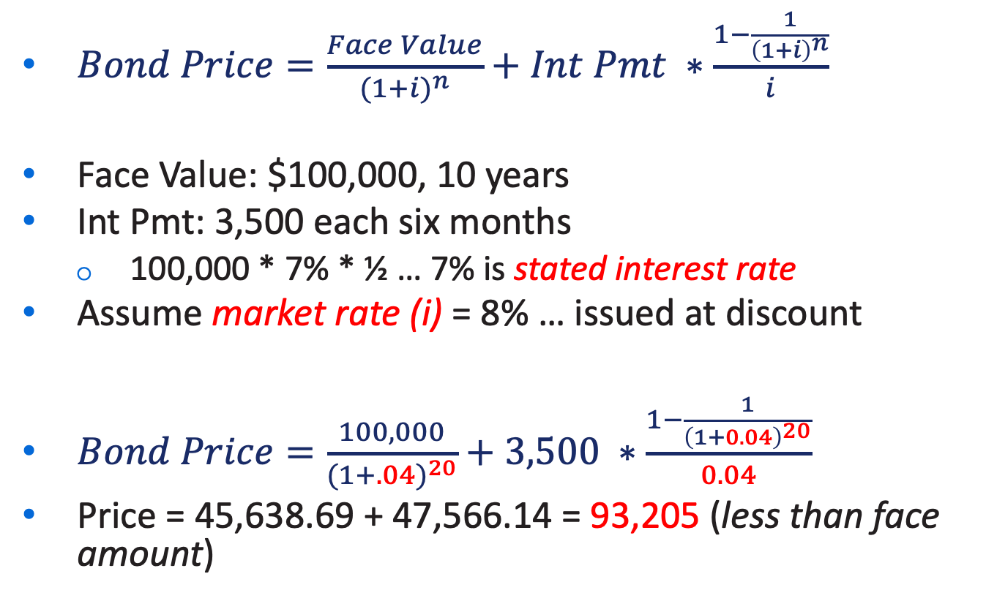
Let’s Verify (Issued at Discount)
$Bond Price=\frac{Face Value}{{(1+i)}^{n}}+Int Pmt ∗\frac{1−\frac{1}{{\left(1+i\right)}^{n}}}{i}$
Face Value: $100,000, 10 years
Int Pmt: 3,500 each six months
100,000 * 7% * ½ … 7% is stated interest rate
Assume market rate (i) = 8% … issued at discount
$Bond Price=\frac{100,000}{{(1+.04)}^{20}}+3,500 ∗\frac{1−\frac{1}{{\left(1+0.04\right)}^{20}}}{0.04}$
Price = 45,638.69 + 47,566.14 = 93,205 (less than face amount)
Notes:
Bond price is determined by investors’ demand … so we need to use market rate
Investing in bond is less attractive than investing in market

Slide 37
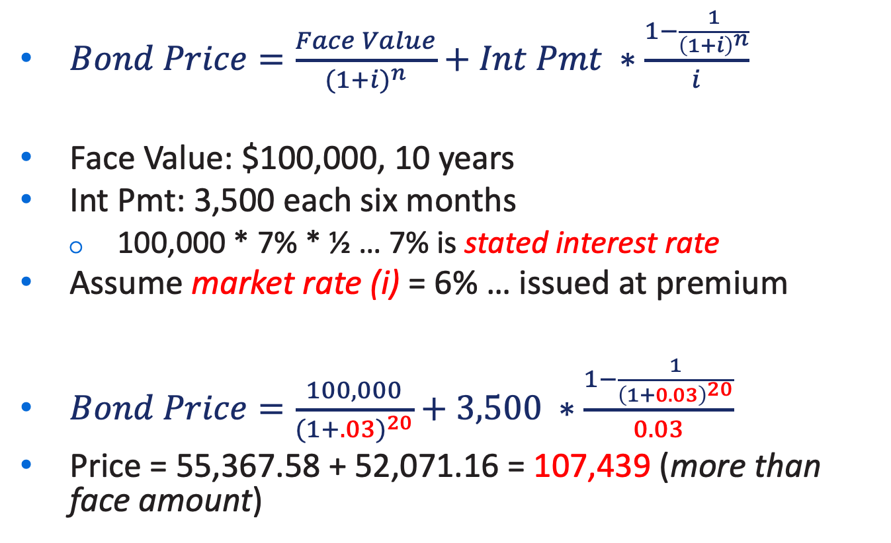
Let’s Verify (Issued at Premium)
$Bond Price=\frac{Face Value}{{(1+i)}^{n}}+Int Pmt ∗\frac{1−\frac{1}{{\left(1+i\right)}^{n}}}{i}$
Face Value: $100,000, 10 years
Int Pmt: 3,500 each six months
100,000 * 7% * ½ … 7% is stated interest rate
Assume market rate (i) = 6% … issued at premium
$Bond Price=\frac{100,000}{{(1+.03)}^{20}}+3,500 ∗\frac{1−\frac{1}{{\left(1+0.03\right)}^{20}}}{0.03}$
Price = 55,367.58 + 52,071.16 = 107,439 (more than face amount)
Notes:
Investing in bond is more attractive than investing in market

Slide 38
Intuition
Market Rate ?
Stated Rate : 7%
Face Amount : 10000
Number of Periods : 3 yrs
Payment period (lets assume annual)

Slide 39
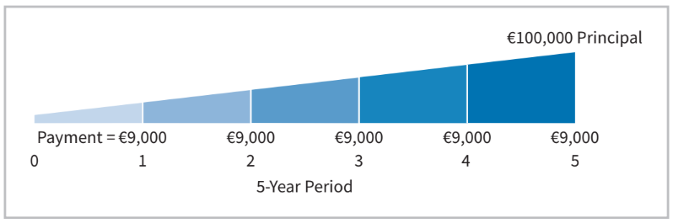
Example: Bond Price
Illustration: Assume that Acropolis SA on January 1, 2025, issues €100,000 of 9% bonds, due in five years, with interest payable annually at year-end. Assume market rate is 9%. What is price of bond?
Present value of €100,000 received in 5 years | € 64,993
Present value of €9,000 received annually for 5 years | 35,007
Market price of bonds | €100,000

Slide 40
Learning Objective 2 Explain How to Account for Bond Transactions.
L O 2

Slide 41
Accounting for Bond Transactions
A company records bond transactions when
it issues (sells) or redeems (buys back) bonds
bondholders convert bonds into ordinary shares (convertible bonds)
Bonds may be issued at
face value (issued at par)
below face value (issued at discount)
above face value (issued at premium)
Bond prices are quoted as a percentage of face value
L O 2

Slide 42
Issuing Bonds at Face Value
Illustration: On January 1, 2025, Candlestick AG issues €100,000, five-year, 10% bonds at 100 (100% of face value). The entry to record the sale is:
Jan. 1
Cash 100,000
Bonds Payable 100,000
Prepare the entry Candlestick would make to accrue interest on December 31.
Dec. 31
Interest Expense 10,000
Interest Payable 10,000
(€100,000 × 10% × 12/12)
L O 2
Notes:
Issue bond: selling bonds for cash. Issuer is borrower.

Slide 43
Issuing Bonds at Face Value – Interest Payment
Prepare the entry Candlestick would make to pay the interest on Jan. 1, 2026.
Jan. 1
Interest Payable 10,000
Cash 10,000
L O 2

Slide 44
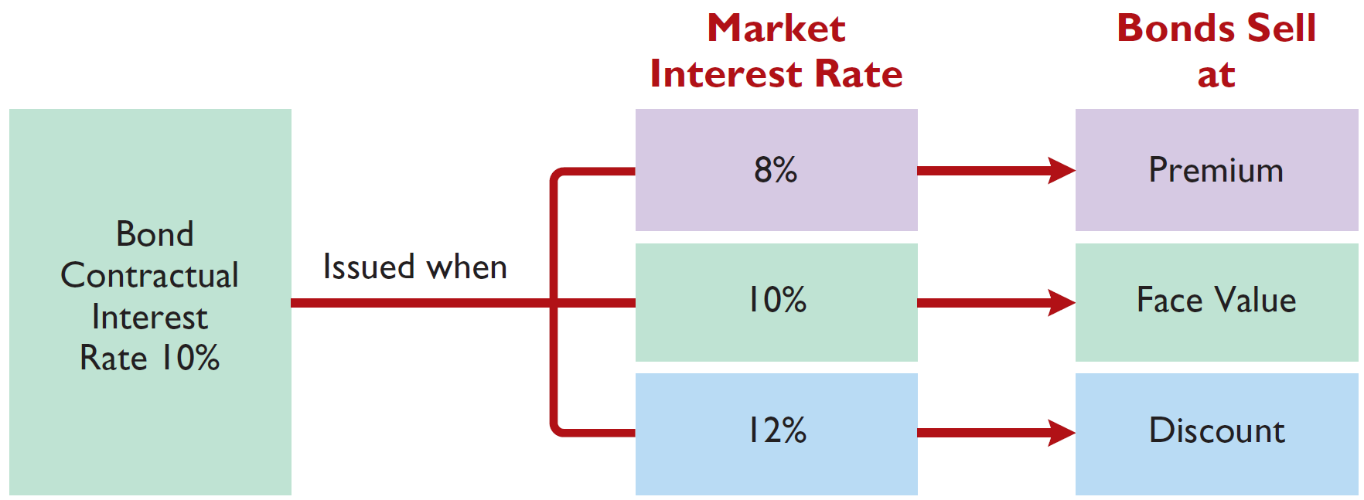
Discount or Premium on Bonds
Interest Rates and Bond Prices
Bond price>principal
Bond price=principal
Bond price<principal
Illustration 11.5: Interest rates and bond prices
L O 2

Slide 45
Issuing Bonds at a Discount – Illustration
Illustration: Assume that on January 1, 2025, Candlestick AG sells €100,000, five-year, 10% bonds for €98,000 (98% of face value). Interest is payable annually on January 1. The entry to record the issuance is as follows.
Jan. 1
Cash 98,000
Bonds Payable 98,000
Where €98,000 is the present value of the bond on January 1st, 2025
L O 2

Slide 46
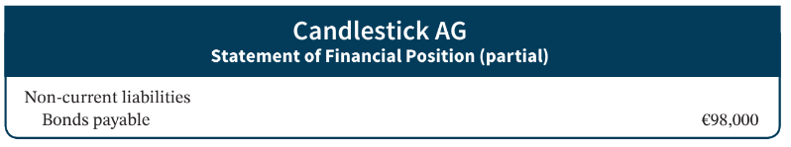
Issuing Bonds at a Discount Example
Statement Presentation
Illustration 11.6: Statement presentation of bonds issued at a discount
The issuing company must pay not only the contractual interest rate over the term of the bonds but also the face value (rather than the issuance price) at maturity.
L O 2

Slide 47
Total Cost of Borrowing Illustrated (1 of 2)
Illustration 11.7: Total cost of borrowing─ bonds issued at a discount. Contractual interest rate < effective market interest rate
Bonds Issued at a Discount
Principal interest | €100,000
Annual interest payments (€10,000 × 5) | 50,000
Cash to be paid to bondholders | 150,000
Less: Cash received from bondholders | 98,000
Total cost of borrowing | €52,000
L O 2

Slide 48
Issuing Bonds at a Discount
Amortization of bond discount:
Allocated to expense in each period
Increases amount of interest expense reported each period
Amount of interest expense reported each period will exceed contractual amount paid
As discount is amortized, its balance declines
Carrying value of bonds will increase, until at maturity carrying value of bonds equals their face amount
L O 2

Slide 49
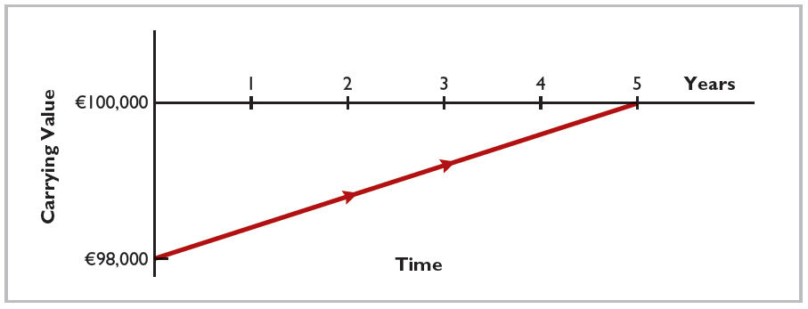
Amortization of Bond Discount
Illustration 11.9: Amortization of bond discount
L O 2

Slide 50
Issuing Bonds at a Premium
Illustration: Assume that the Candlestick AG bonds previously described sell for €102,000 (102% of face value) rather than for €98,000. The entry to record the sale is as follows:
Jan. 1
Cash 102,000
Bonds Payable 102,000
L O 2

Slide 51
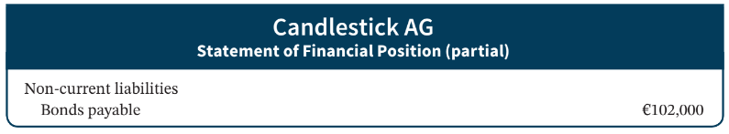
Issuing Bonds at a Premium – Presentation
Statement Presentation
Illustration 11.10: Statement presentation of bonds issued at a premium
The borrower is not required to pay the bond premium at the maturity date of the bonds. Thus, the bond premium is considered to be a reduction in the cost of borrowing.
L O 2

Slide 52
Total Cost of Borrowing Illustrated (2 of 2)
Illustration 11.7: Total cost of borrowing─ bonds issued at a premium
Contractual interest rate > effective market interest rate
Bonds Issued at a Premium
Principal interest | €100,000
Annual interest payments (€10,000 × 5) | 50,000
Cash to be paid to bondholders | 150,000
Less: Cash received from bondholders | 102,000
Total cost of borrowing | €48,000
Illustration 11.12: Alternative computation of total cost of borrowing─ bonds issued at a premium
L O 2

Slide 53
Bond Premium Amortization
Allocated to expense in each period
Decreases amount of interest expense reported each period
Amount of interest expense reported each period will be less than contractual amount paid
As premium is amortized, its balance declines
Carrying value of bonds will decrease, until at maturity carrying value of bonds equals their face amount
L O 2

Slide 54
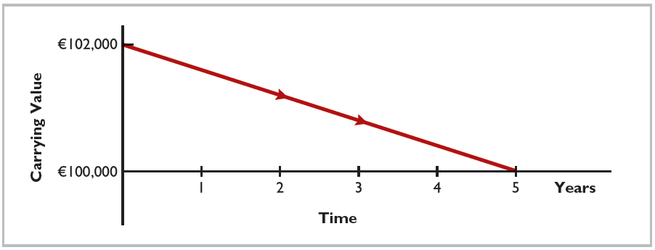
Amortization of Bond Premium
Illustration 11.13: Amortization of bond premium
L O 2

Slide 55
Discount or Premium on Bonds – Review Question
Karson Ltd. issues 10-year bonds with a maturity value of £200,000. If the bonds are issued at a premium, this indicates that:
the contractual interest rate exceeds the market interest rate.
the market interest rate exceeds the contractual interest rate.
the contractual interest rate and the market interest rate are the same.
no relationship exists between the two rates.
L O 2

Slide 56
Discount or Premium on Bonds – Solution
Karson Ltd. issues 10-year bonds with a maturity value of £200,000. If the bonds are issued at a premium, this indicates that:
the contractual interest rate exceeds the market interest rate. (Correct)
the market interest rate exceeds the contractual interest rate.
the contractual interest rate and the market interest rate are the same.
no relationship exists between the two rates.
L O 2

Slide 57
DO IT! 2a: Bond Issuance
Giant Ltd. issues ¥200,000,000 of bonds for ¥189,000,000. (a) Prepare the journal entry to record the issuance of the bonds, and (b) show how the bonds would be reported on the statement of financial position at the date of issuance.
L O 2

Slide 58
DO IT! 2a: Bond Issuance – Solution
a.
Cash 189,000,000
Bonds Payable 189,000,000
b.
Non-current liabilities
Bonds payable ¥189,000,000
L O 2

Slide 59
Redeeming Bonds at Maturity
Candlestick AG records the redemption of its bonds at maturity as follows:
Jan. 1
Bonds Payable 100,000
Cash 100,000
L O 2

Slide 60
Redeeming Bonds before Maturity (1 of 2)
When a company retires bonds before maturity, it is necessary to:
eliminate carrying value of bonds at redemption date
record cash paid
recognize gain or loss on redemption
The carrying value of the bonds is the face value of the bonds less unamortized bond discount or plus unamortized bond premium at the redemption date. It is the net book value of the bond reported in financial statements.
It is a little bit like sale of PPE.
L O 2

Slide 61
Redeeming before Maturity Example
Illustration: Assume at the end of the fourth period, Candlestick AG having sold its bonds at a premium, retires the bonds at 103 after paying the annual interest [Note: operationally, companies retire bond by directly purchasing bond from investors, 103 is the price of the bond as percentages]. Assume that the carrying value of the bonds at the redemption date is €100,476 [net book value reported on balance sheet]. Candlestick records the redemption at the end of the fourth interest period (January 1, 2029) as follows:
Jan. 1
Bonds Payable 100,476
Loss on Bond Redemption 2,524
Cash 103,000
L O 2

Slide 62
DO IT! 2b: Bond Redemption
R & B Ltd. issued £500,000, 10-year bonds at a discount. Prior to maturity, when the carrying value of the bonds is £496,000, the company redeems the bonds at 98 (£500,000 × 98% = £490,000) . Prepare the entry to record the redemption of the bonds.
L O 2

Slide 63
DO IT! 2b: Bond Redemption – Solution
Bonds Payable 496,000
Gain on Bond Redemption 6,000
Cash 490,000
L O 2

Slide 64
Retire bond before maturity
Bond, just like stocks, are traded publicly on the market.
Companies sometimes purchase their own bond on the market.
Because the purchasing price (redeeming price) may differ from the net book value of the bond (carrying value), there could be a loss or gain on income statement as other income/losses.

Slide 65
Retire bond before maturity
Why do companies sometimes retire bond before maturity?
Have extra cash and wish to reduce their debt
The bond price is too low
However, decreasing bond price is a signal of financial stress. In practice, while companies may want to retire bond early when the price is low, they may not have the ability to do so for various reasons.

Slide 66
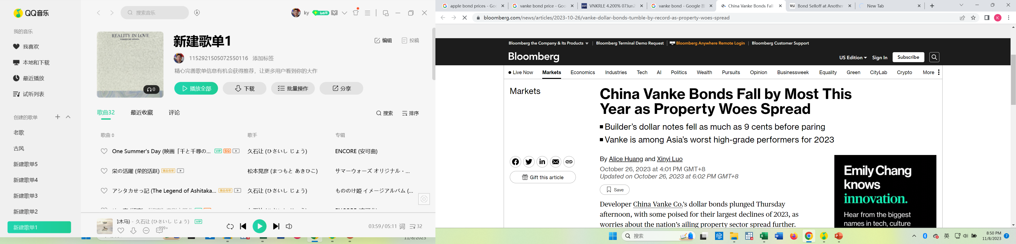
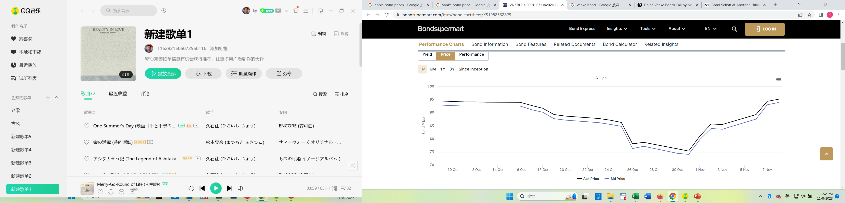
Case in point
Fitch Ratings downgraded Vanke in late Oct 2023.
Vanke’s bond price dropped (its stock price also dropped if you follow the news)

Slide 67

Case in point
Ideally Vanke could purchase its bond from the market at 75 -> show confidence to the market and reduce the debt at the same time

Slide 68
Case in point
Ideally Vanke could purchase its bond from the market at 75 -> show confidence to the market and reduce the debt at the same time
But the problem is that the bond is denominated in the US dollars. To retire its bond, Vanke would have to borrow money from oversea banks, it is very costly.
https://new.qq.com/rain/a/20231031A078D400

Slide 69

Case in point

Slide 70
Bond issuance
Interest Rates and Bond Prices
Bond price>principal
Bond price=principal
Bond price<principal
Illustration 11.5: Interest rates and bond prices
L O 2

Slide 71
Bond Retirement
Bond retired at the maturity date
Bond retired before the maturity date
DR Bond payable, DR Cash, DR or CR gain/loss on bond redemption
Illustration 11.5: Interest rates and bond prices
L O 2

Slide 72
Learning Objective 5 Apply the Effective-Interest Method of Amortizing Bond Discount and Bond Premium.
L O 5

Slide 73
Effective-Interest Method (1 of 2)
Amortization of the discount or premium results in interest expense equal to a constant percentage of the carrying value.
Required steps:
Compute bond interest expense.
Compute bond interest paid or accrued.
Compute amortization amount.
L O 5

Slide 74
Effective-Interest Method Computation
Amortization of the discount or premium results in interest expense equal to a constant percentage of the carrying value.
bond interest expense is different from interest paid when bond is issued at discount or premium!!!
Illustration 11A.1: Computation of amortization─effective-interest method
L O 5

Slide 75
Amortizing Bond Discount - Journal
Illustration: Assume that on January 1, 2025, Candlestick AG sells €100,000, five-year, 10% bonds for €98,000 (98% of face value). The effective market interest rate is 10.5348%
Cash 98,000
Bonds Payable 98,000
L O 5

Slide 76
Amortizing Bond Discount - Journal
Illustration: Candlestick AG records the accrual of interest and amortization of bond discount on Dec. 31, as follows:
Year 1 Dec. 31
Interest Expense 10,324
Bonds Payable 324
Interest Payable 10,000
Step 1. Interest Expense = carrying value at the beg period (98,000) * effective market interest rate (10.5348%)=10324
Step 2. Interest paid: face value * contractual rate =10,000
Step 3. Amortization: 324
L O 5

Slide 77
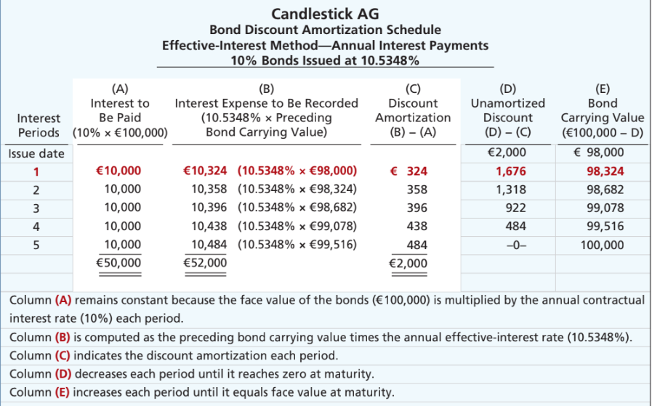
Bond Discount Amortization Schedule
Illustration 11A.2: Bond discount amortization schedule
L O 5

Slide 78
Amortizing Bond Discount - Journal
Illustration: Candlestick AG records the accrual of interest and amortization of bond discount on Dec. 31, as follows:
Year 2 Dec. 31
Interest Expense 10,358
Bonds Payable 358
Interest Payable 10,000
Step 1. Interest Expense = carrying value at the beg period (98,324) * effective market interest rate (10.5348%)=10358
Step 2. Interest paid: face value * contractual rate =10,000
Step 3. Amortization: 358
L O 5

Slide 79
Amortization of Bond Discount
Illustration 11.9: Amortization of bond discount
L O 2

Slide 80
Amortizing Bond Premium
Illustration: Candlestick AG sells the bonds described above for €102,000 rather than €98,000. This would result in a bond premium of €2,000 (€102,000 − €100,000). This premium results in an effective-interest rate of approximately 9.4794%.
L O 5

Slide 81
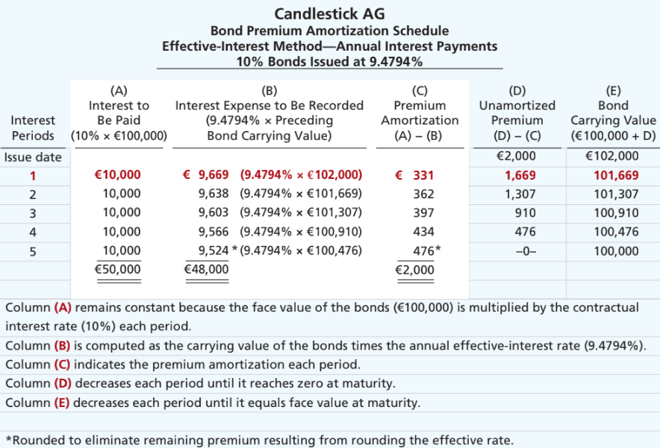
Bond Premium Amortization Schedule
Illustration 11A.4: Bond premium amortization schedule
L O 5

Slide 82
Amortizing Bond Premium - Journal
Illustration: Candlestick AG records the accrual of interest and amortization of premium discount on Dec. 31, as follows:
Dec. 31
Interest Expense 9,669
Bonds Payable 331
Interest Payable 10,000
Bond interest paid (€100,000 × 10%) | €10,000
Less: Bond interest expense (€102,000 × 9.4794%) | 9,669
Bond premium amortization | € 331
Illustration 11A.5: Computation of bond premium amortization
L O 5

Slide 83
Amortization of Bond Premium
Illustration 11.13: Amortization of bond premium
L O 2

Slide 84
Learning Objective 4 Discuss How Liabilities are Reported and Analyzed.
L O 4

Slide 85
Analysis (Current liability)
1. Working Capital (a concept you will see in advanced finance courses when talking about M&As or LBO)
Current Assets | − | Current Liabilities | = | Working Capital
2. Current ratio a liquidity ratio that measures a company's ability to cover its short-term obligations with its current assets
Current Assets | ÷ | Current Liabilities | = | Current Ratio
L O 2

Slide 86
Analysis (Non-Current liability)
Two ratios that provide information about debt-paying ability and long-run solvency are:
Debt to Assets Ratio
Times Interest Earned Ratio
L O 4

Slide 87
Analysis Example
To illustrate these ratios, we will use data from an LG (KOR) annual report. The company had total liabilities of ₩ 22,839 billion, total assets of ₩ 35,528 billion, interest expense of ₩ 827 billion, income taxes of ₩ 354 billion, and net income of ₩ 223 billion.
Total Liabilities | ÷ | Total Assets | = | Debt to Assets Ratio
₩22,839 | ÷ | ₩35,528 | = | 64.3%
Net Income + Interest Expense + Income Tax Expense | ÷ | Interest Expense | = | Times Interest Earned
₩223 + ₩827 + ₩354 | ÷ | ₩827 | = | 1.70 times
Illustration 11.16: Debt to assets and times interest earned rations, with computations (in billions)
L O 4

Slide 88
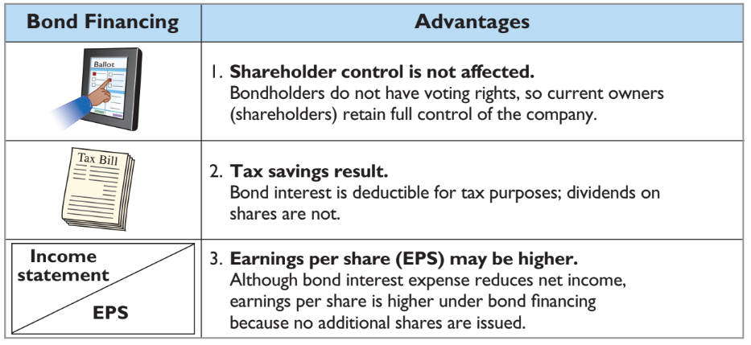
Bond Financing Advantages
Illustration 11.17: Advantages of bond financing over ordinary shares
L O 4

Slide 89
Debt and Equity Financing Example
Illustration: Microsystems is considering two plans for financing the construction of a new €5 million plant. Plan A involves issuance of 200,000 ordinary shares at the current market price of €25 per share. Plan B involves issuance of €5 million, 8% bonds at face value. Income before interest and taxes on the new plant will be €1.5 million. Income taxes are expected to be 30%. Microsystems currently has 100,000 ordinary shares outstanding.
The alternative effects on the return on common shareholders’ equity are shown in the next Illustration.
L O 4

Slide 90
Financing Effects on Earnings
 | Plan A Issue Shares | Plan B Issue Bonds
Income before interest and taxes | €1,500,000 | €1,500,000
Interest (8% × €5,000,000) | — | 400,000
Income before income taxes | 1,500,000 | 1,100,000
Income tax expense (30%) | 450,000 | 330,000
Net income | € 1,050,000 | € 770,000
Outstanding shares | 300,000 | 100,000
Earnings per share | €3.50 | €7.70
Higher interest expense
Tax lower
No share dilution
Higher EPS
Illustration 11.18: Effects on earnings per share─ equity vs. debt
L O 4

